Slide 1
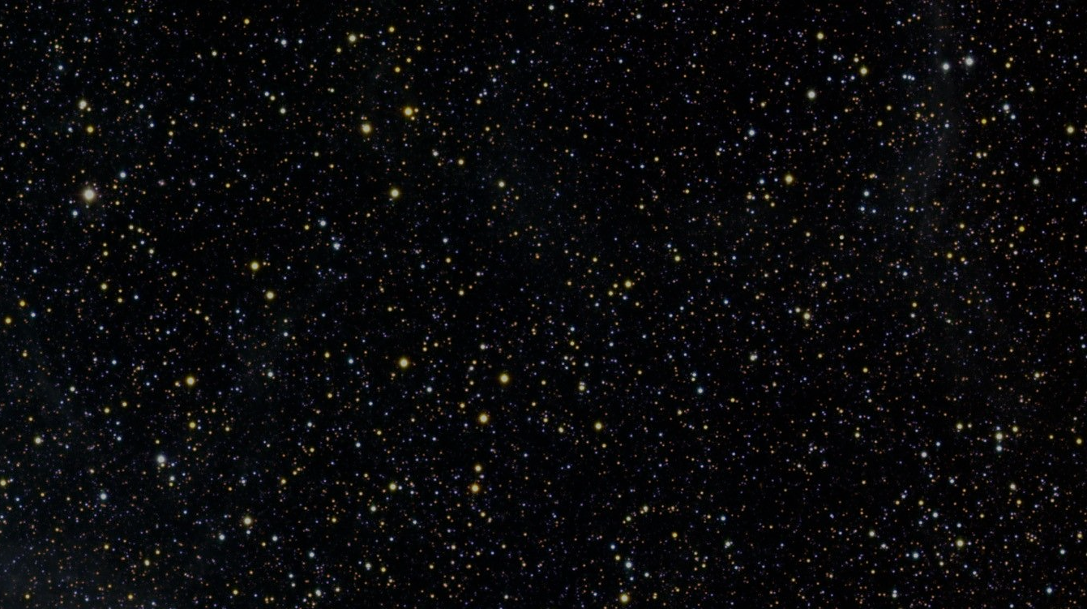

Sound Visualization with an Acoustic Camera
Lino Mediavilla

Slide 2
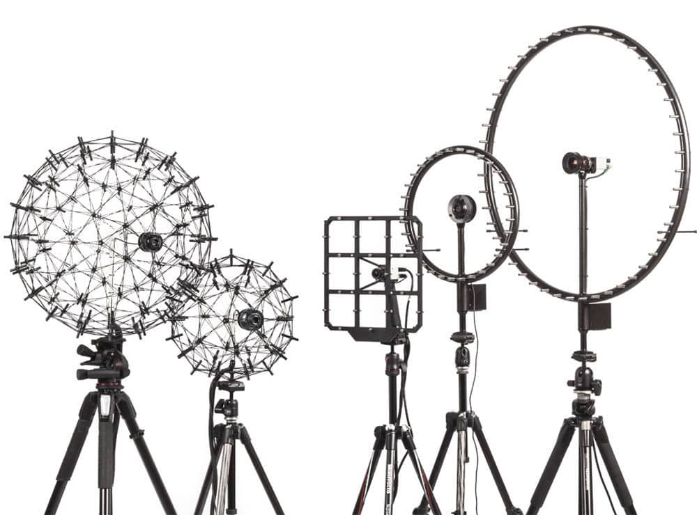
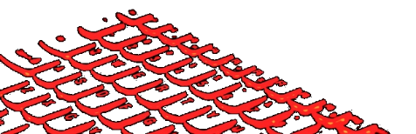
Agenda
Introduction & Motivation
Methodology
Processing Algorithm
Array Design
Hardware & Software components
Results
Discussion & Conclusions

Slide 3
Introduction & Motivation

Slide 4
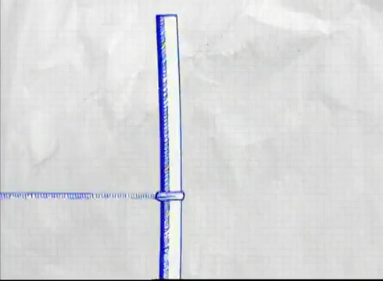
What is sound?
Source: gpd.com

Slide 5
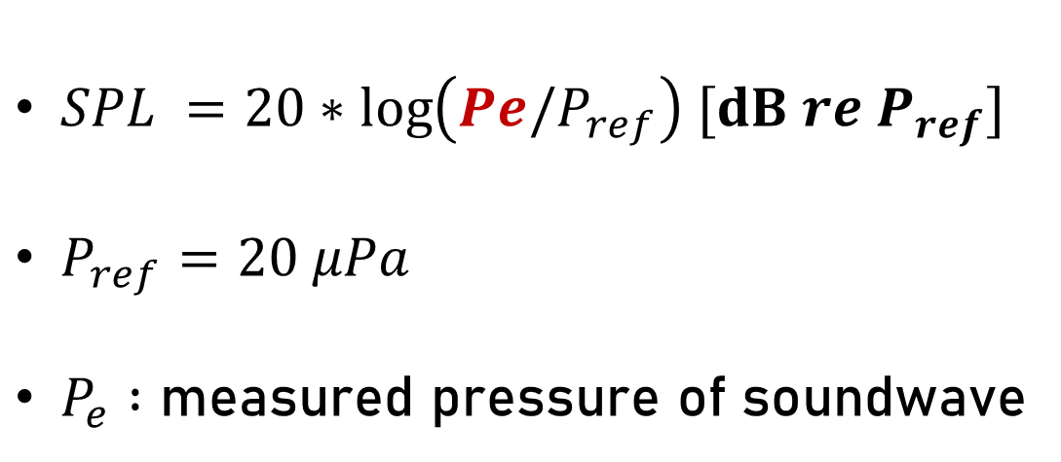
How is it measured?
Sound pressure level
$SPL =20∗\log\left(Pe/P_{ref}\right) [dB re{ P}_{ref}]$
$P_{ref}=20 μPa$
$P_{e} :$ measured pressure of soundwave

Slide 6
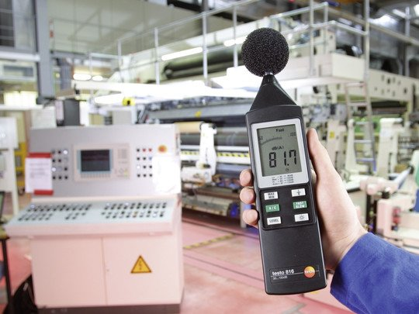
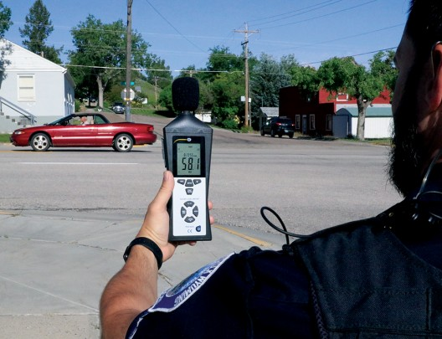
How is it measured?
Source: Boels.it
Source: gpd.com

Slide 7
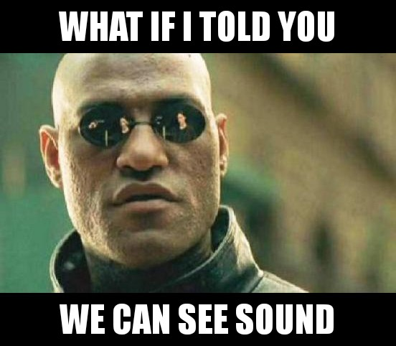

Slide 8
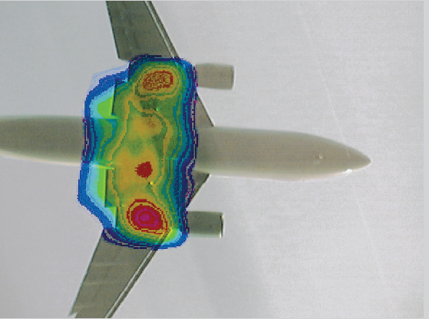
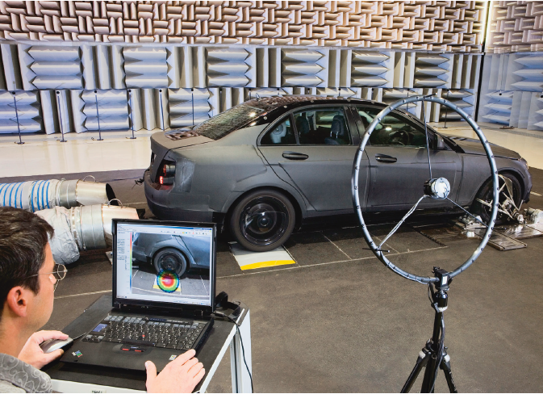
Acoustic cameras produce acoustic maps
Microphone array
Digital Cam.
Location, strength & spectrum
Source: GFAI
Source: GFAI
Processing Software

Slide 9
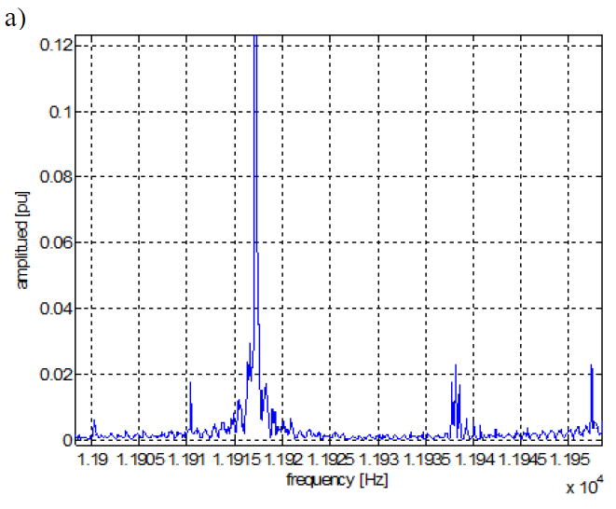
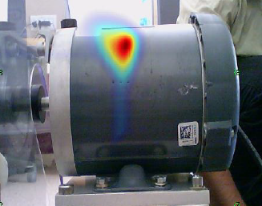
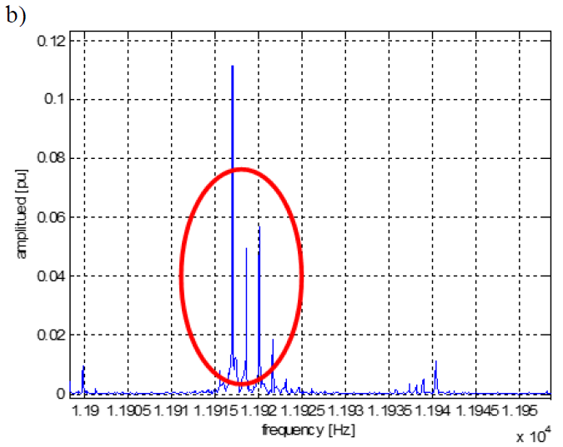
Acoustic maps are of great interest
Diagnosis without dismantling
Broken rotor bar
Healthy
Source: 3D printed acoustic camera for electric motor diagnosis (Orman et. al, 2014).

Slide 10
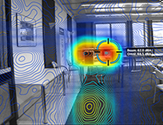
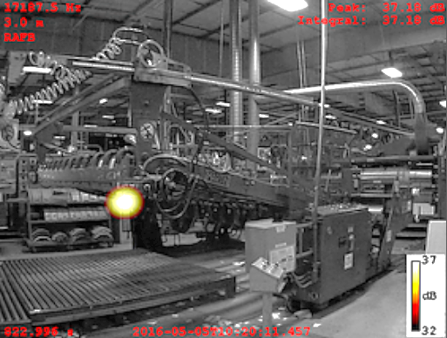
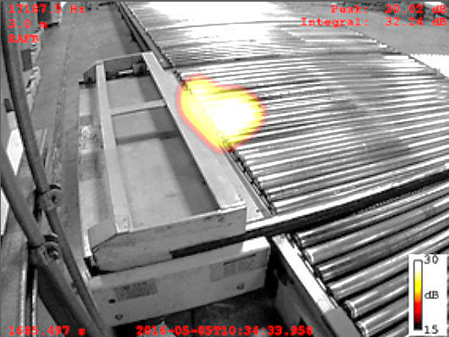
Acoustic maps are of great interest
Sound leakage detection
Compressed air leaks
Source: The Acoustic Camera as a valid tool to gain additional information over traditional methods in architectural acoustics (Ortiz et. al, 2015).
Source: Compressed Air leak detection and identification system (Optinav)

Slide 11
Methodology: Processing Algorithm

Slide 12
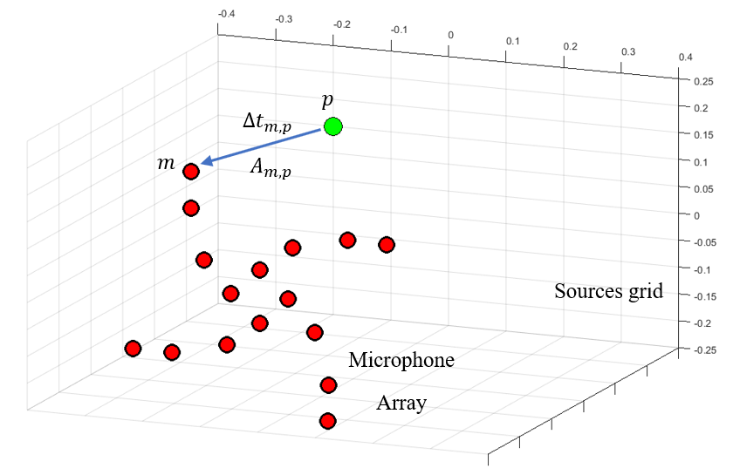

Sound Pressure Level of source $p$

Slide 13
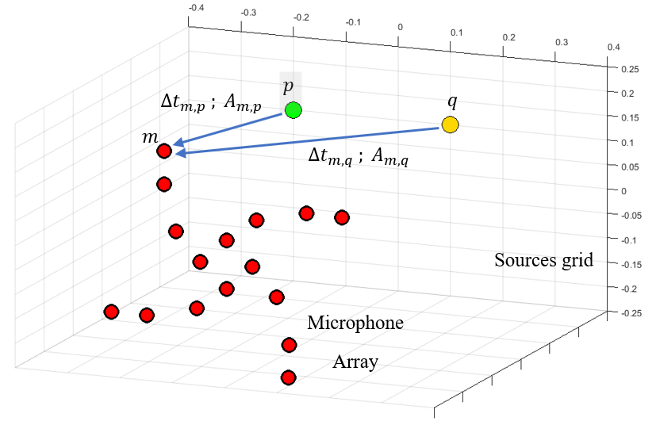
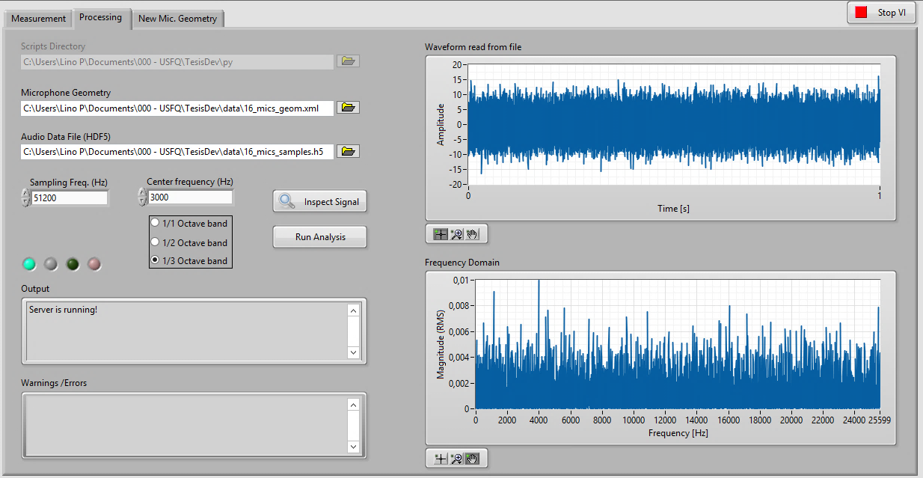

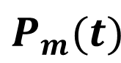
What we measure
$$P_{m}(t)$$
Isolate contribution from $p$

Slide 14
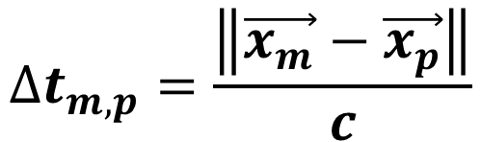
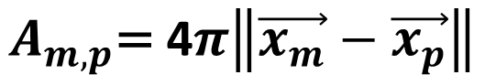
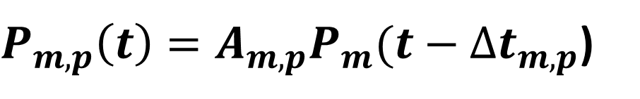
$P_{m,p}\left(t\right)=A_{m,p}P_{m}(t−∆t_{m,p}$)
What we measure
Amplitude
$$A_{m,p}\text{= }\text{4}π\left\|\vec{x_{m}}−\vec{x_{p}}\right\|$$
Phase
$$∆t_{m,p}=\frac{\left\|\vec{x_{m}}−\vec{x_{p}}\right\|}{c}$$
Source: Acoustic beamforming for noise source localization – Reviews, methodology and applications. Mechanical Systems and Signal Processing. (Chiariotti et. Al, 2019)

Slide 15
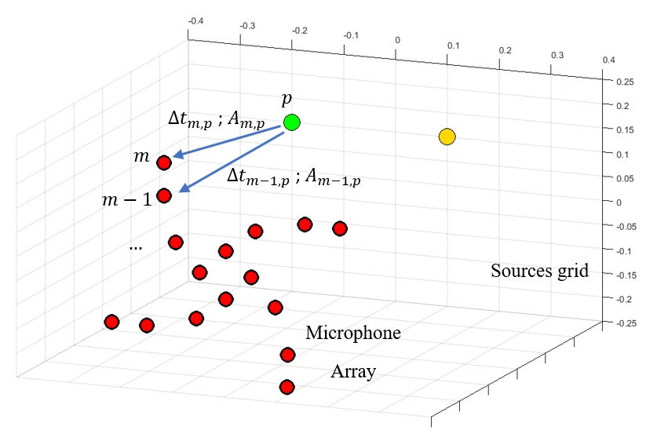
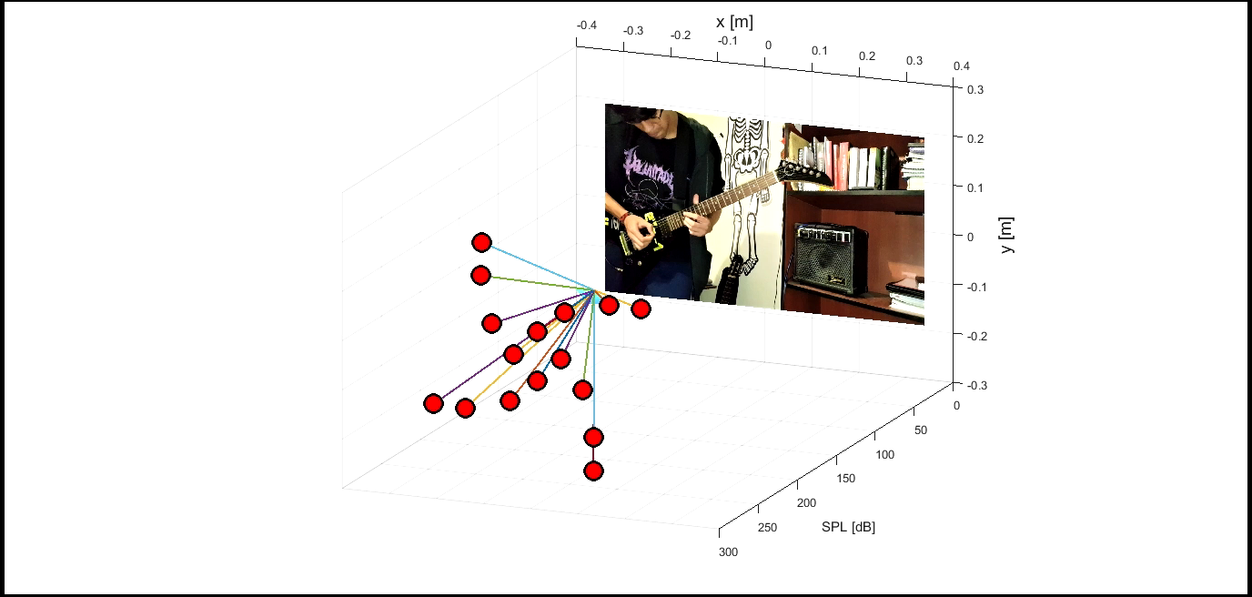

Repeat for all the other mics…
$$P_{p}\left(t\right)=\frac{1}{N}\sum_{m=1}^{N}{A_{m,p}P_{m}(t−∆t_{m,p})}$$
Then repeat for all points in the grid!

Slide 16
Methodology: Array Design

Slide 17
Microphone placement affects performance
Unresolved
Speakers
Resolved
Desirable:
Wide dynamic range
High spatial resolution
Source: Effects of array scaling and advanced beamforming algorithms on the
angular resolution of microphone array systems (Aldeman & Raman, 2018).

Slide 18
Microphone placement affects performance
Only actual source
Ghost sources
Undesirable:
Spatial Aliasing
Source: Suppression of spatial aliasing using moving arrays (Cigada et.al, 2008).

Slide 19
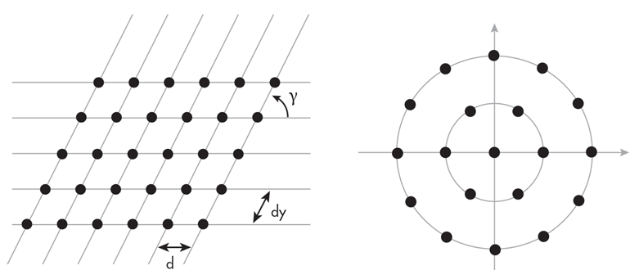
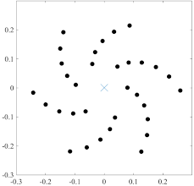
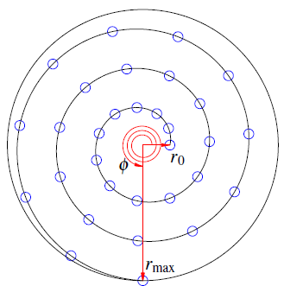
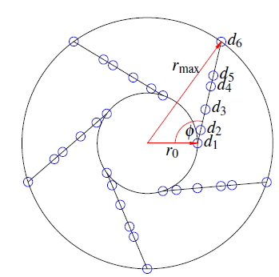
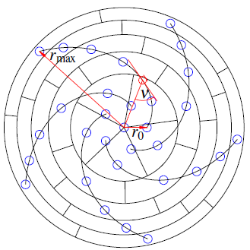
Spiral arrays: the sweet spot
Source: Acoustic beamforming for noise source localization (Chiariotti et. al., 2019).
Source: A comparison of popular beamforming arrays (Prime & Doolan, 2013).

Slide 20
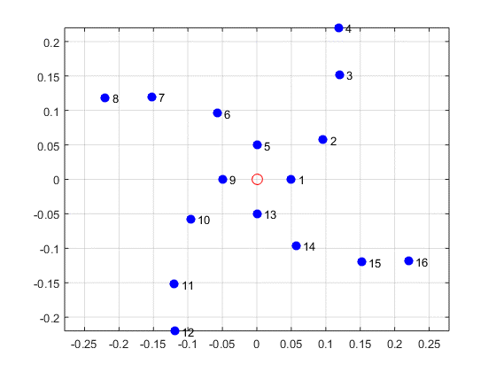
Spiral arrays: the sweet spot
Underbrink spiral: best performance (Prime & Doolan, 2013).
F parameter: 0.274
Ideal F parameter: 1

Slide 21
Methodology: Hardware & Software components

Slide 22



Workflow
Acquisition
Processing
Results
Source: GFAI
Source: GFAI

Slide 23
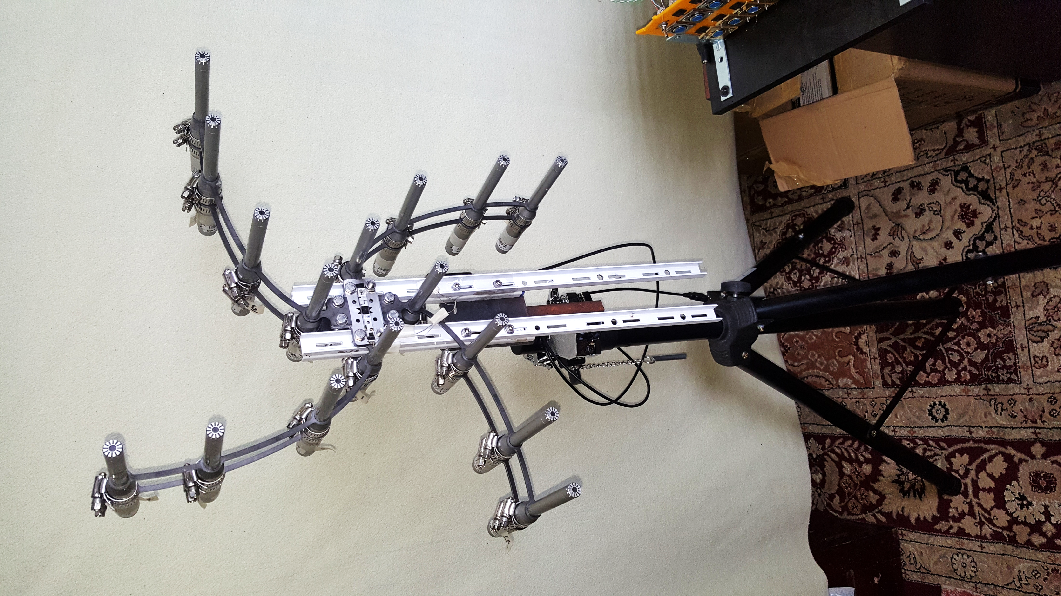
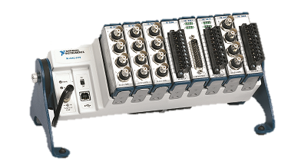
Hardware components
Behringer
ECM-8000
NI cDAQ 9178
Webcam

Slide 24



Acoular: an open source processing library
Source: A Python framework for microphone array data processing (Sarradj & Herold, 2017).
E. Sarradj & G. Herold
Beamforming algorithms
Key optimizations

Slide 25
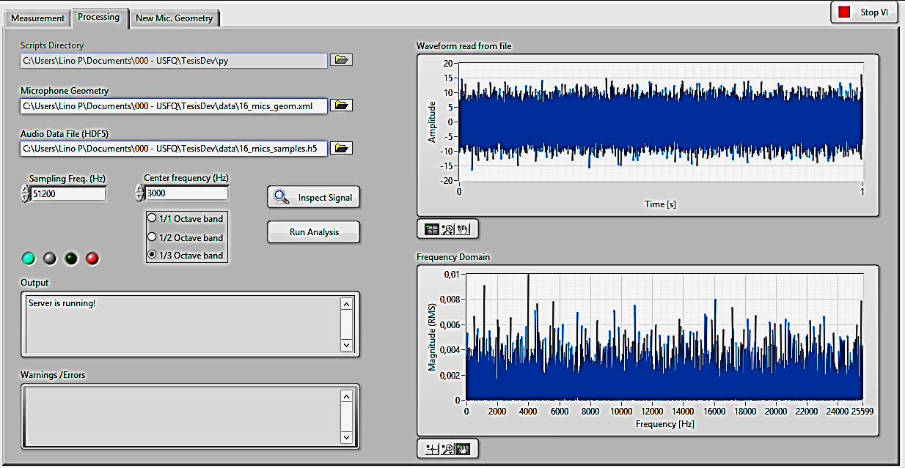
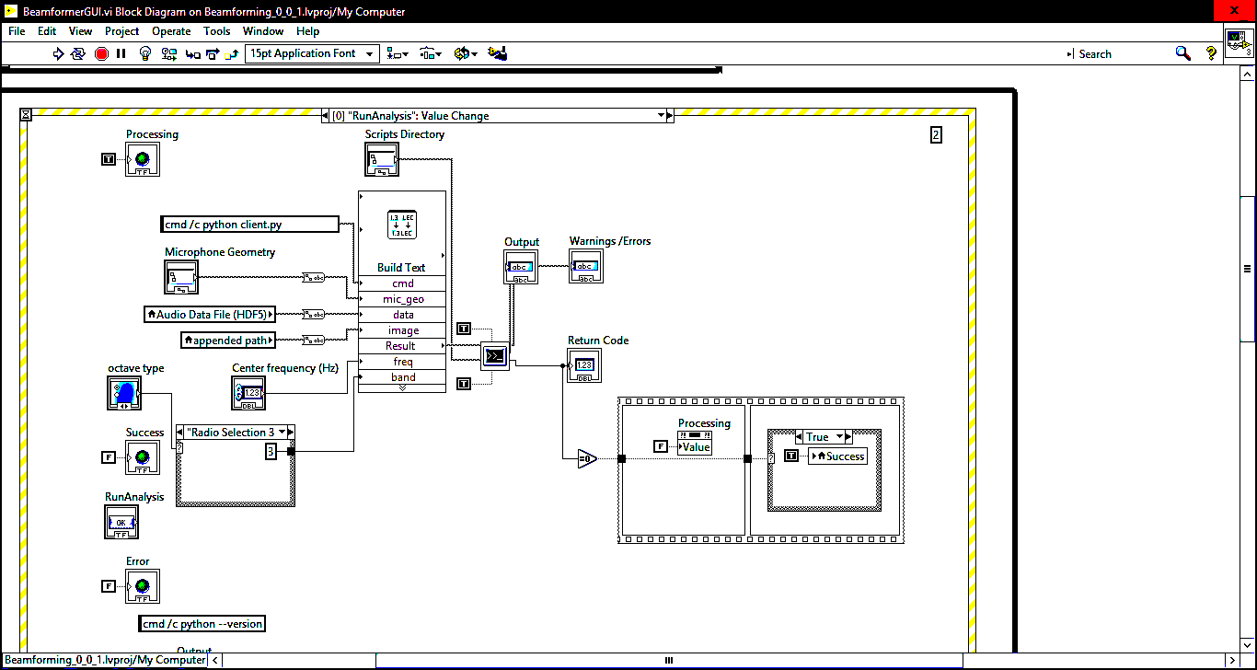
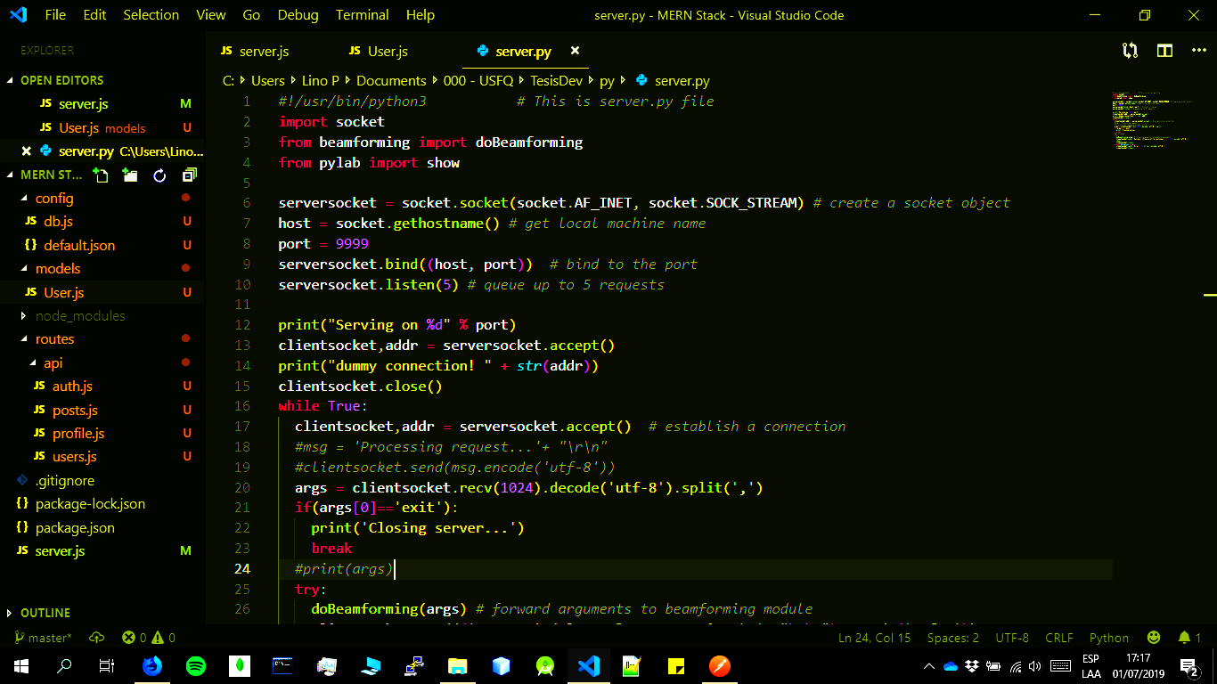
Software Components
LabView UI
Python server
Acquisition
Processing
Results

Slide 26
Results

Slide 27
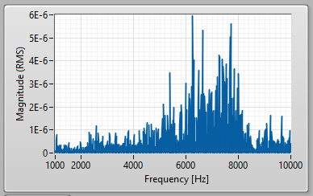
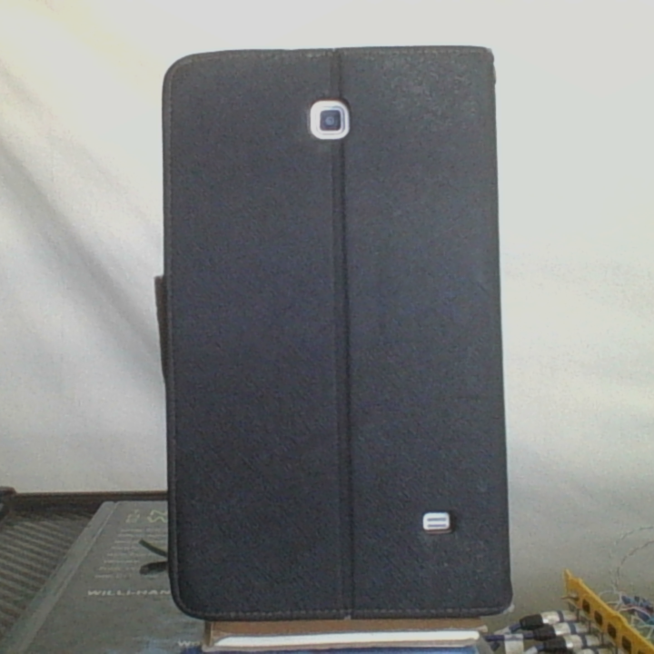
One Source (white noise)
Speaker

Slide 28
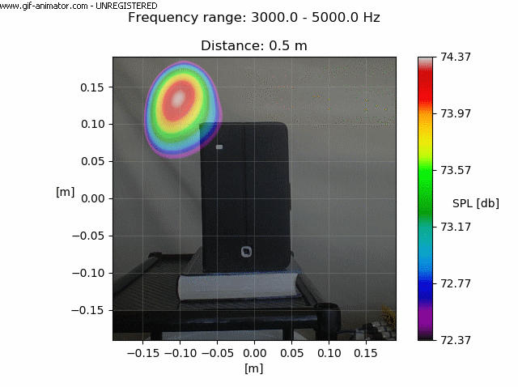
SPL @ Center: 78.4 db
0.5 m

Slide 29
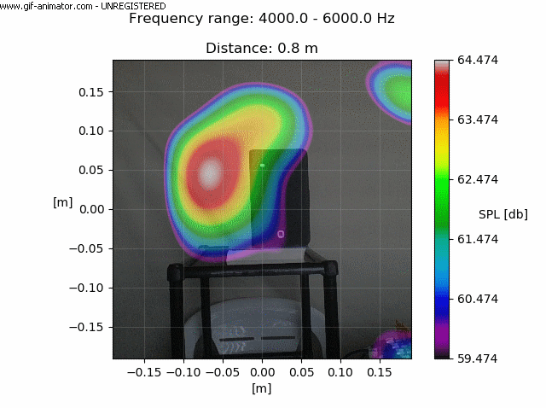
SPL @ Center: 68.2 db
0.8 m

Slide 30
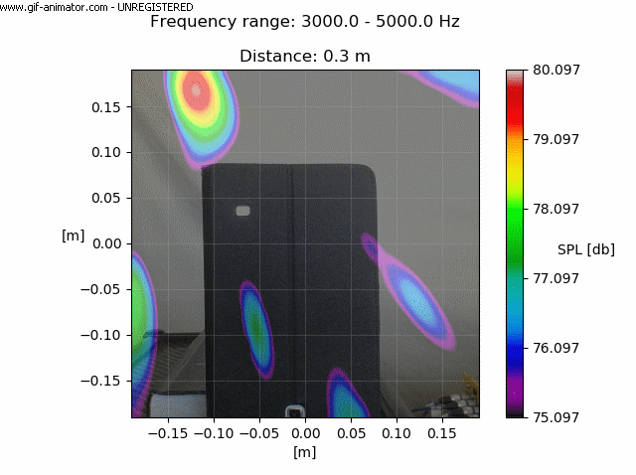
SPL @ Center: 84.7 db
0.3 m

Slide 31
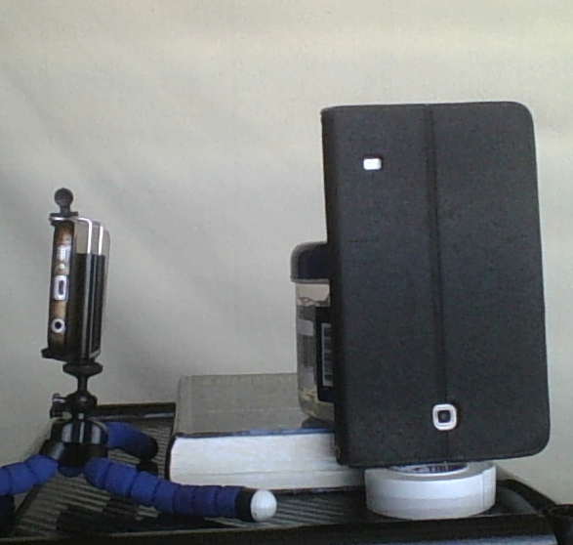
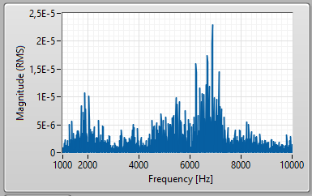
Two Sources (both white noise)
Tablet
SPL @ Center: 72.0 db
Phone
SPL @ Center: 77.2 db

Slide 32
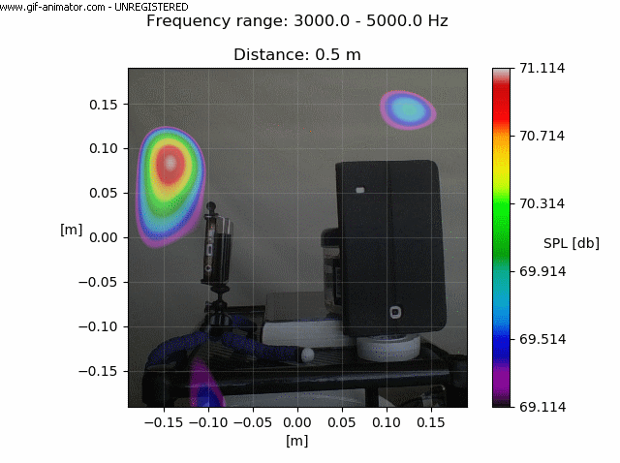
SPL @ Center:
72.0 db (tablet)
77.2 db (phone)
0.5 m

Slide 33
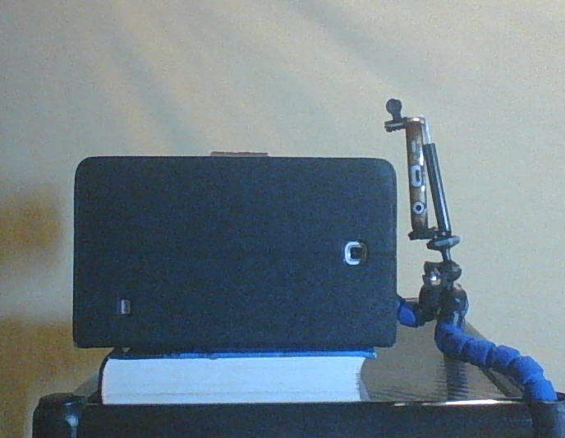
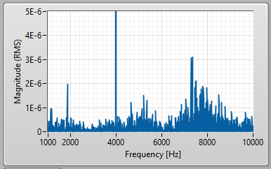
Two Sources (different sounds)
Phone
Pure tone,
4 kHz
Tablet
White Noise

Slide 34
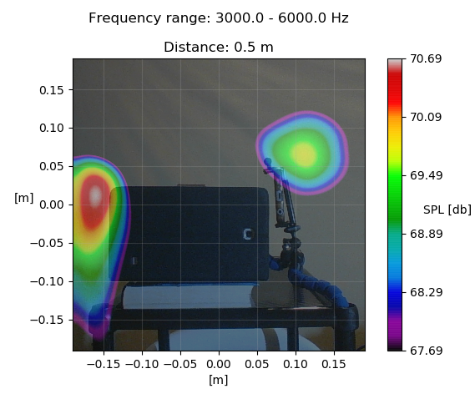

Slide 35
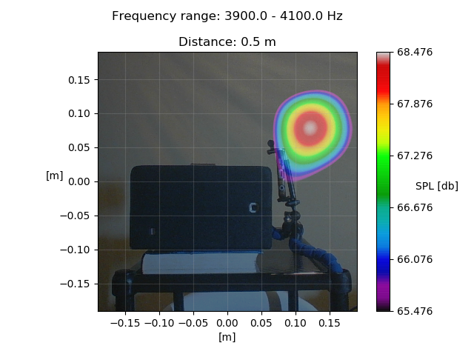

Slide 36
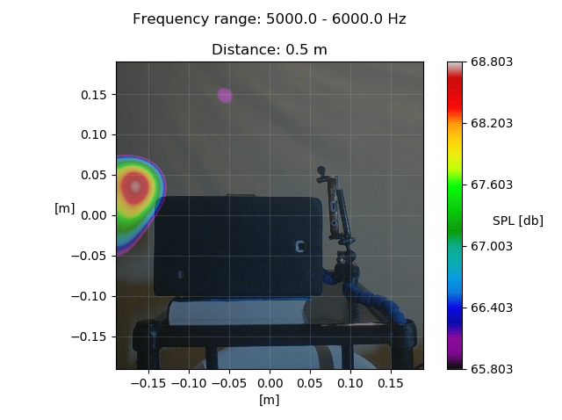

Slide 37
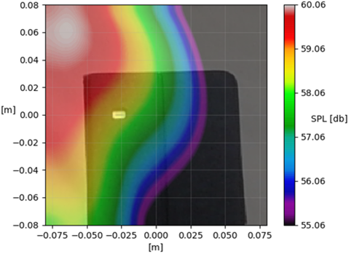


Room for improvement
Acoustic Map
Localization Error (cm) | 7.2 | 5.4 | 4.0
Pressure Level Error (db SPL) | 1.9 | 4.4 | 1.9

Slide 38
Room for improvement
Issue | Proposed solution
Narrow frequency range | Geometry with higher F parameter
Asymmetric response | More symmetric geometry
Intensity error | Calibration with professional SPL meter
Localization error | Enforce alignment of microphones and camera. Lower discrepancies in sensor positions.

Slide 39
Conclusions
Acoustic cameras: to characterize unknown sound sources (location, intensity and spectrum).
Current prototype: locates and characterizes sound sources (asymmetry, narrow frequency range, visible localization error).
The device works best within a distance of 0.5 - 0.8 meters.
An advance towards the development of an acoustic camera has been made.

Slide 40
Thanks for your attention

Slide 41
References
Aldeman, M., & Raman, G. (2018). Effects of array scaling and advanced beamforming algorithms on the angular resolution of microphone array systems. Applied Acoustics, 132(November 2017), 58–81. https://doi.org/10.1016/j.apacoust.2017.11.009
Chiariotti, P., Martarelli, M., & Castellini, P. (2019). Acoustic beamforming for noise source localization – Reviews, methodology and applications. Mechanical Systems and Signal Processing, 120, 422–448. https://doi.org/10.1016/j.ymssp.2018.09.019
Orman, M., Rzeszucinski, P., & Pinto, C. T. (2014). 3D printed acoustic camera for electric motor diagnostics. (Icaicte), 43–47. https://doi.org/10.2991/icaicte-14.2014.10
Ortiz, N. M., Barré, S., & Vonrhein, B. (2015). The acoustic camera as a valid tool to gain additional information over traditional methods in architectural acoustics. Energy Procedia, 78, 122–127. https://doi.org/10.1016/j.egypro.2015.11.126
Prime, Z., & Doolan, C. (2013). A comparison of popular beamforming arrays. (November), 1–7.
Sarradj, E., & Herold, G. (2017). A Python framework for microphone array data processing. Applied Acoustics, 116, 50–58. https://doi.org/10.1016/j.apacoust.2016.09.015

